Slide 1
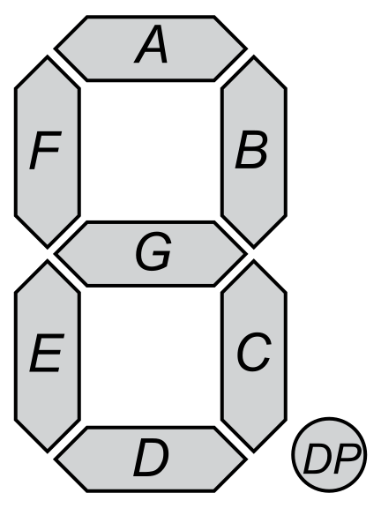
Introduction to 7 Segment Display
Agenda
Today We'll learn about 7 segment display and it's arduino usage

Slide 2
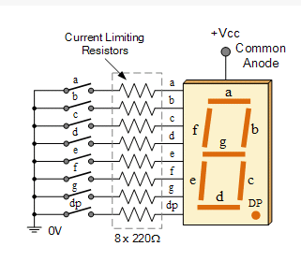
What is 7 segment display?
An LED or Light Emitting Diode, is a solid state optical pn-junction diode which emits light energy in the form of photons.The main advantage of light emitting diodes is that because of their small die size, several of them can be connected together within one small and compact package producing what is generally called a 7-segment Display.

Slide 3

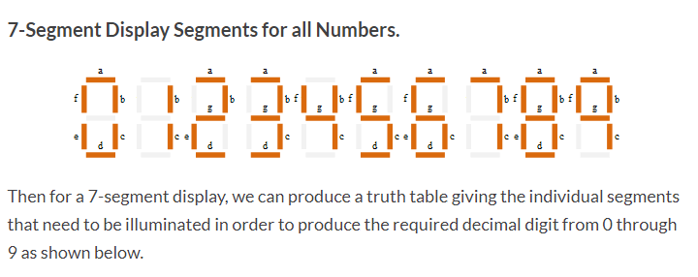
Why 7 Segment?

Slide 4
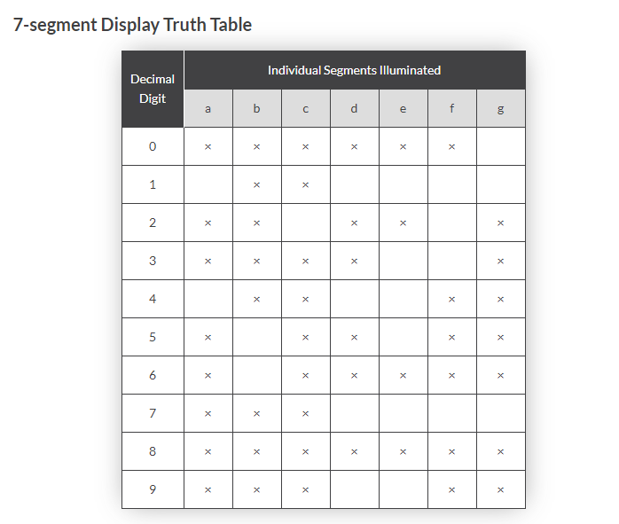
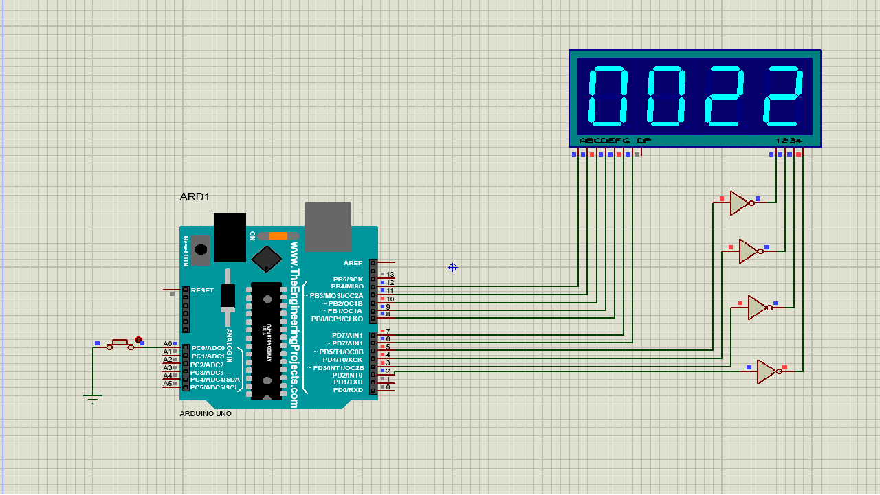
Truth Table of 7 segment
Here "x" means switch is closed/connected so that current can pass through that pin

Slide 5
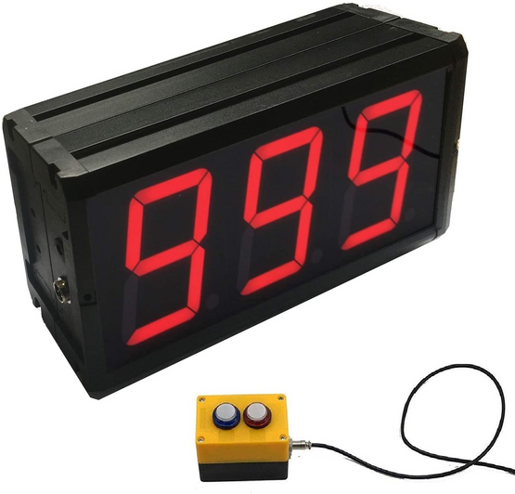
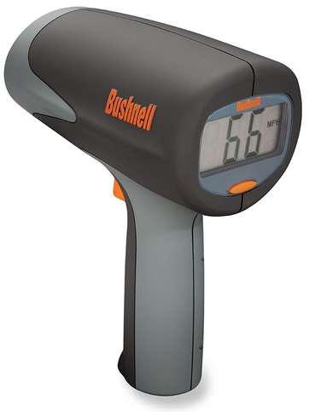
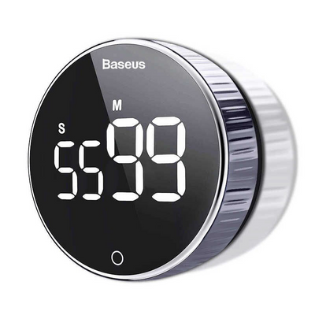
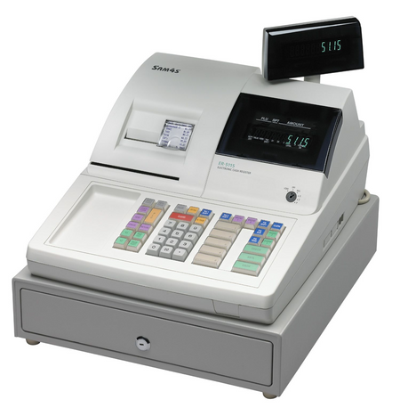
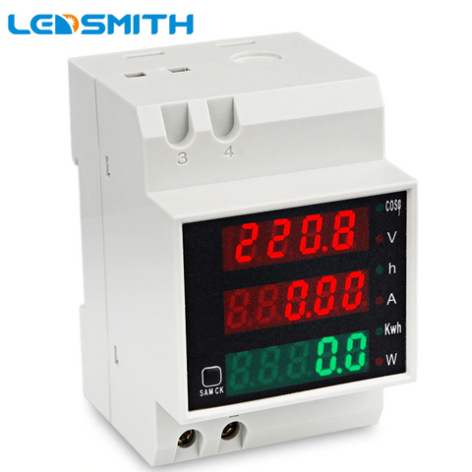

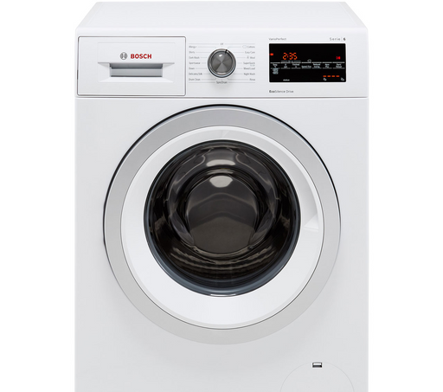
Some Use Case
Counter
Speed measuring device
Digital Clock
Cashier machine
Digital meter
Microwave oven
Washing machine
etc.

Slide 6
Lets see codes &Simulation

Slide 7
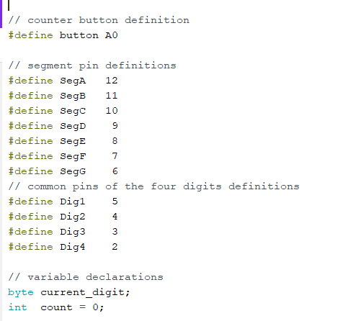

Slide 8
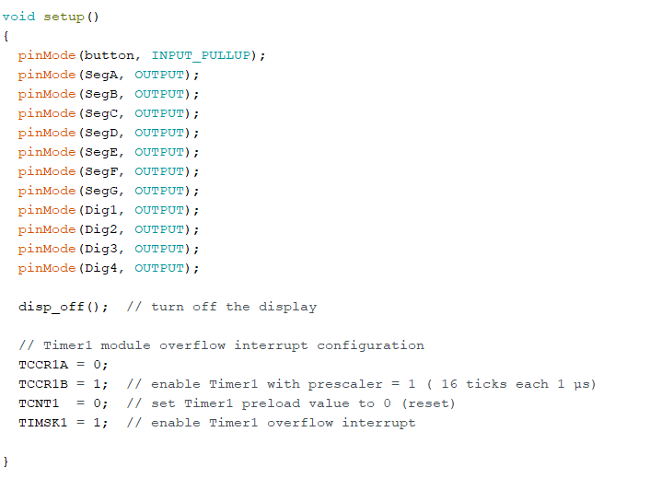

Slide 9
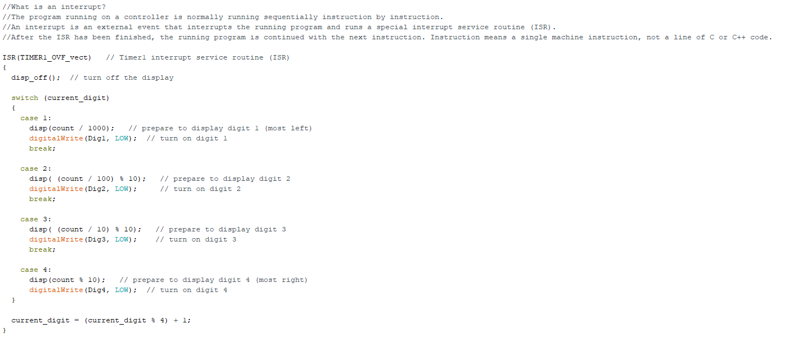

Slide 10
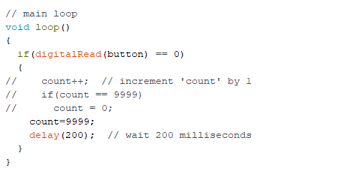

Slide 11
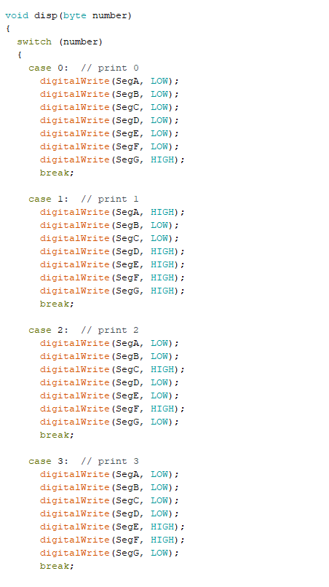
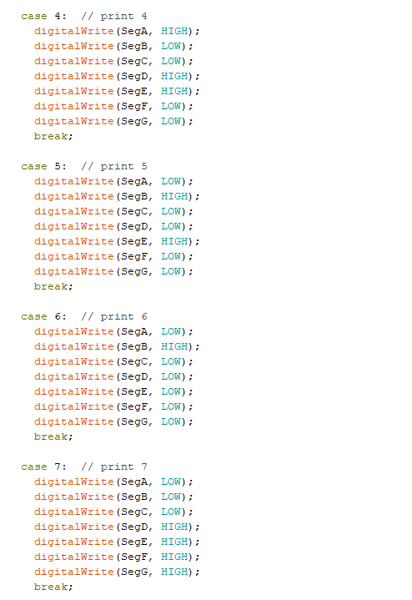


Slide 12


Slide 13
QUIZ?
What's a 7 segment display?
Write the orientation of 7 segment display for the number 5.
Is there any need of 7 segment display in 2020?Give proper reasoning for your answer.

